Slide 1
5.1 Exponents
Algebra Concepts

Slide 2
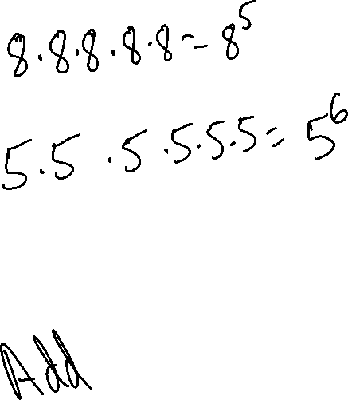
Multiplying Using Exponents
Multiplying Using Exponents
8³ • 8² means
5² • 5⁴ means
What did we do with the exponents?

Slide 3
Multiplying Using Exponents
Rule:
*When the bases are the same, add the exponents.

Slide 4
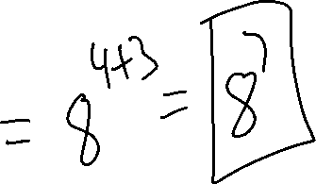
Example 1
Example 1

Slide 5
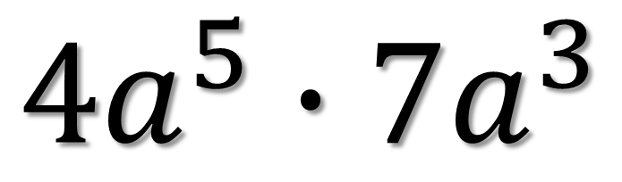
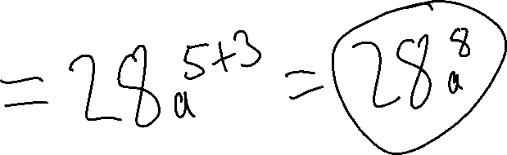
Example 1
Example 2
$${4a}^{5}∙{7a}^{3}$$

Slide 6
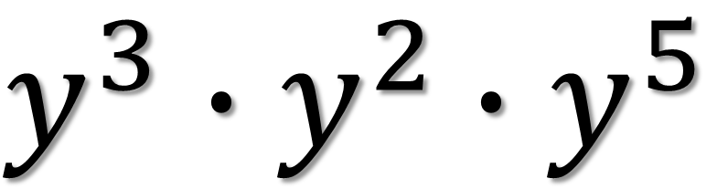
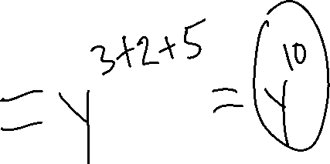
Example 1
Example 3
$y^{3}∙y^{2}$ $∙y^{5}$

Slide 7
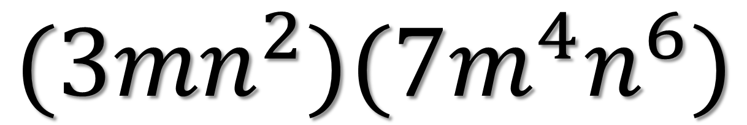
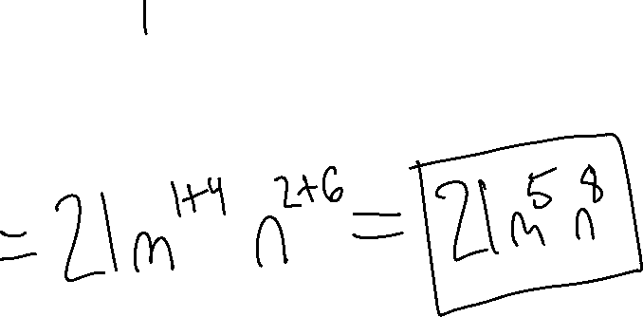
Example 1
Example 4
$${(3mn}^{2})(7m^{4}n^{6})$$

Slide 8
Dividing Using Exponents
Rule:
*When the bases are the same, subtract the exponents.

Slide 9

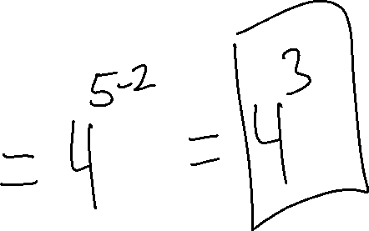
Example 1
Example 5
$$\frac{4^{5}}{4^{2}}$$

Slide 10

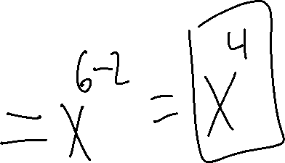
Example 1
Example 6
$$\frac{x^{6}}{x^{2}}$$

Slide 11

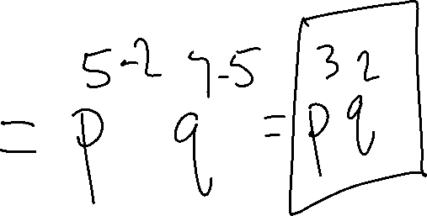
Example 1
Example 7
$$\frac{p^{5}q^{7}}{p^{2}q^{5}}$$

Slide 12

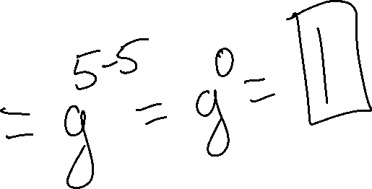
Example 1
Example 8
$$\frac{g^{5}}{g^{5}}$$

Slide 13
Negative Exponents
Rule:
*Never Leave Negative Exponents

Slide 14

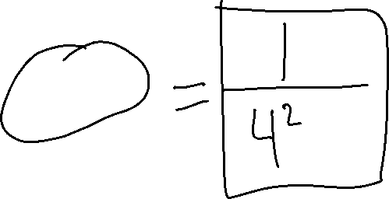
Example 1
Example 9
$$4^{−2}$$

Slide 15

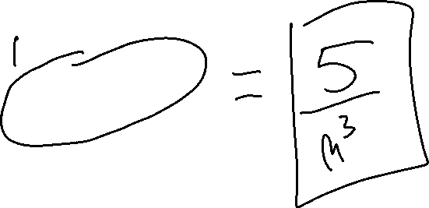
Example 1
Example 10
$${5m}^{−3}$$

Slide 16

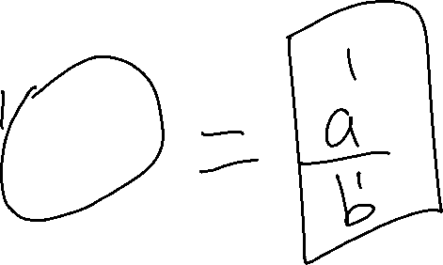
Example 1
Example 11
$${ab}^{−1}$$

Slide 17
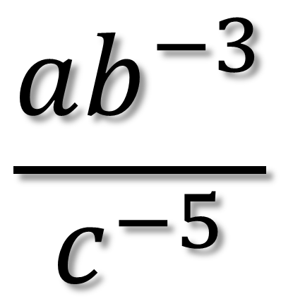
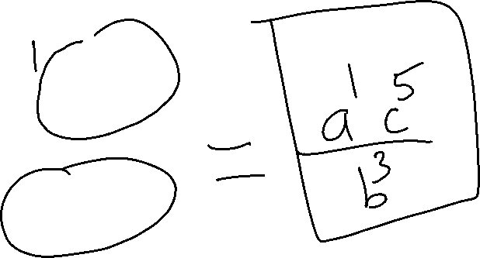
Example 1
Example 12
$$\frac{ab^{−3}}{c^{−5}}$$

Slide 18

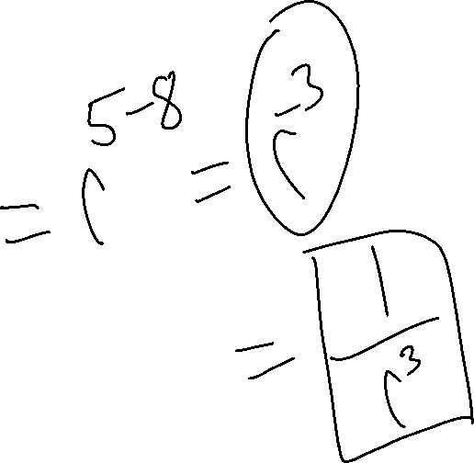
Example 13
$$\frac{r^{5}}{r^{8}}$$

